Slide 1

AWS DynamoDB-
NoSQL Service
SYS-360

Slide 2
NoSQL
NoSQL databases (aka "not only SQL") are non tabular, and store data differently than relational tables.
A common misconception is that NoSQL databases or non-relational databases don’t store relationship data well.
NoSQL databases can store relationship data—they just store it differently than relational databases

Slide 3
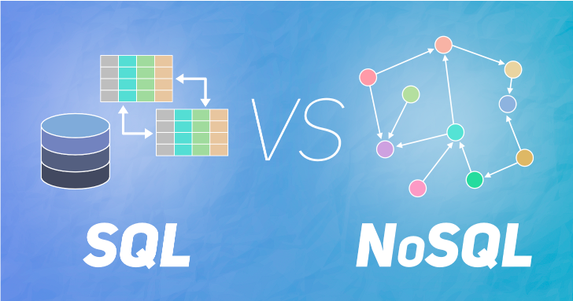
Elasticsearch and NoSQL
NoSQL data models allow related data to be nested within a single data structure - and not in separate “tables” like traditional relational databases.

Slide 4
SQL Example
Let’s say you had data on customer information which your sales team queried regularly.
Using a tradition relational database, you decide to optimize storage in two tables
one for basic information
one pertaining to being a customer
with last name being the key to both tables.
Each row in each table is a single customer, and each column has the following fixed attributes - Two Tables:
Last name :: first name :: middle initial :: address fields :: email address :: phone number
Last name :: date of birth :: account number :: customer years :: communication preferences

Slide 5
NoSQL Example
With NoSQL, we can store the same data in an unstructured format
Combine both the basic information and the customer information in one JSON document.
each of the SQL column attributes would be fields
and the details of a customer’s record would be the data values associated with each field.
For example: Last_name: "Jones", First_name: "Mary", Middle_initial: "S", etc
No tables needed - just one document per customer.
Can be indexed/searched using the field/value pairs - just as you do with a search engine!

Slide 6
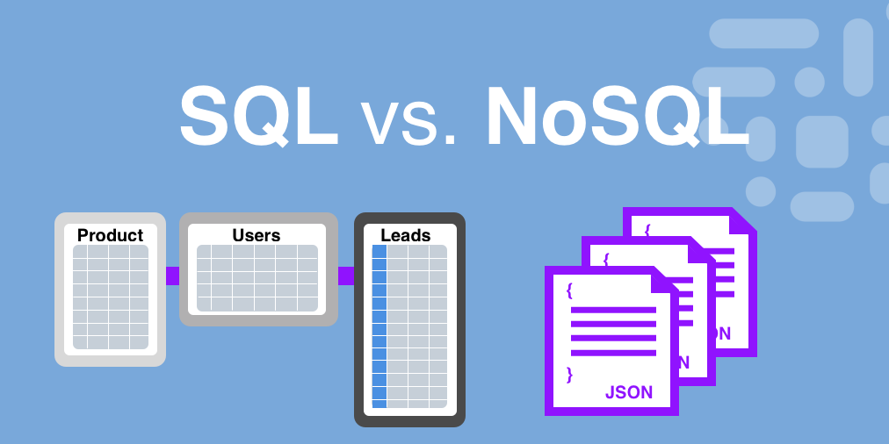
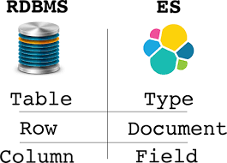

Slide 7
Why NoSQL has become Popular
Recently, the cost of storage dramatically decreased.
Gone were the days of needing to create a complex, difficult-to-manage data model simply for the purposes of reducing data duplication.
Developers (rather than storage) were becoming the primary cost of software development, so NoSQL databases optimized for developer productivity.
Also
As storage costs decreased, the amount of data applications needed to store and query increased.
This data came in all shapes and sizes—structured, semistructured, and polymorphic—
and defining the schema in advance became nearly impossible.

Slide 8
DynamoDB - AWS NoSQL Service
In DynamoDB, tables, items, and attributes are the core components that you work with.
A table is a collection of items,
and each item (think “record” in a database)
is a collection of attributes.
DynamoDB uses:
primary keys to uniquely identify each item in a table
and secondary indexes to provide more querying flexibility.
You can use DynamoDB Streams to capture data modification events in DynamoDB tables.

Slide 9
DynamoDB Table
Tables:
Similar to other database systems, DynamoDB stores data in tables.
A table is a collection of data.
An example table called People could be used to store personal contact information about friends, family, or anyone else of interest.
A Cars table could store information about vehicles that people drive.

Slide 10
DynamoDB - Items
Items – An item is a group of attributes that is uniquely identifiable among all of the other items.
In a People table, each item represents a person.
For a Cars table, each item represents one vehicle.
Items in DynamoDB are similar in many ways to rows, records, or tuples in other database systems. I
n DynamoDB, there is no limit to the number of items you can store in a table.

Slide 11
DynamoDB- Attributes
Attributes – Each item is composed of one or more attributes. An attribute is a fundamental data element, something that does not need to be broken down any further.
An item in a People table contains attributes called PersonID, LastName, FirstName, and so on.
Attributes in DynamoDB are similar in many ways to fields or columns in other database systems.

Slide 12
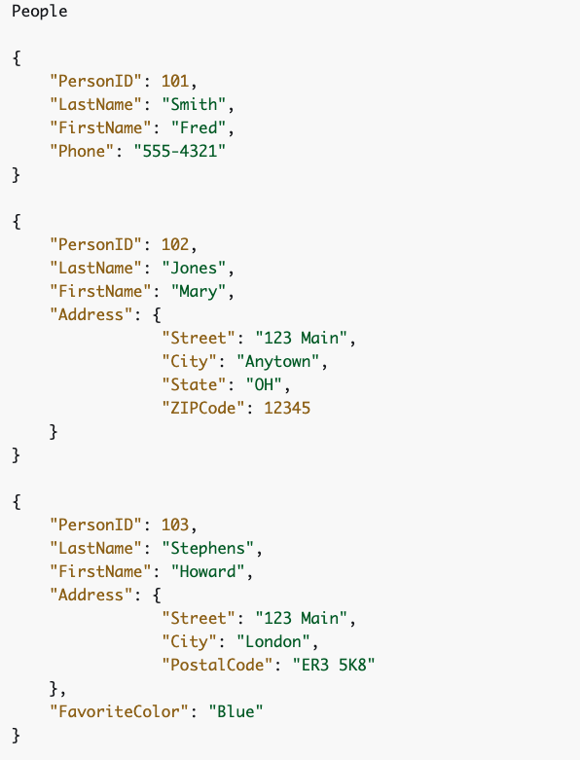
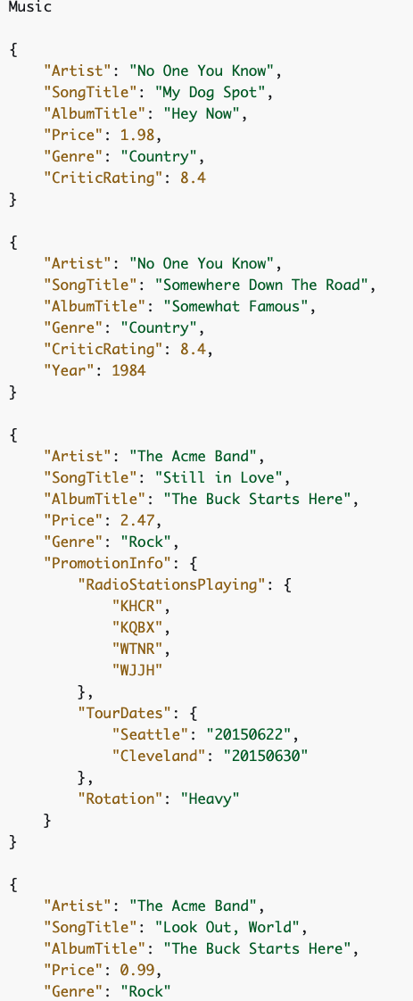
Table Examples

Slide 13
Secondary Indexes
Can create one or more secondary indexes on a table. A secondary index lets you query the data in the table using an alternate key, in addition to queries against the primary key.
DynamoDB doesn't require that you use indexes, but they give your applications more flexibility when querying your data.
After you create a secondary index on a table, you can read data from the index in much the same way as you do from the table.

Slide 14
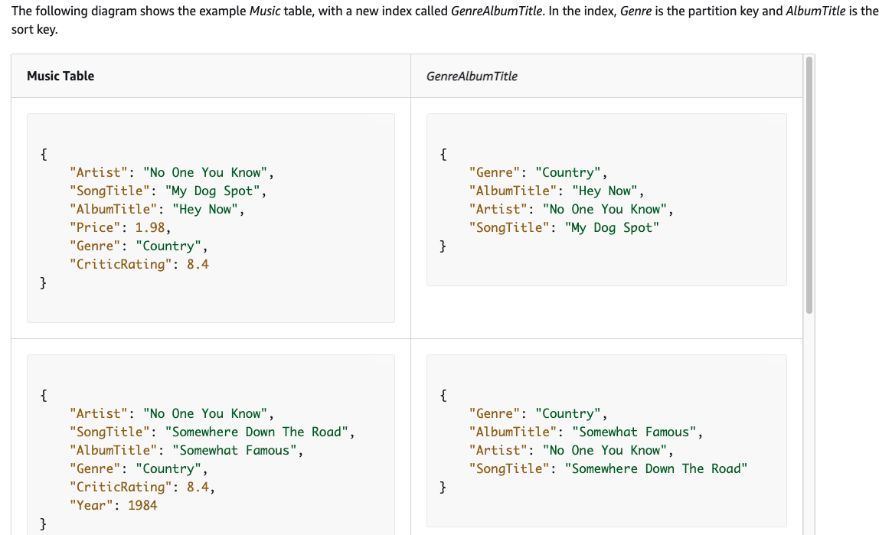

Slide 15
